Slide 1
Deep Learning with PyTorch It starts with a tensor
闫滢钰2020.08.05

Slide 2
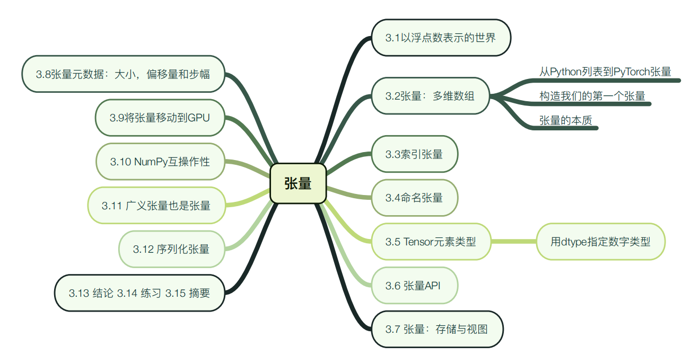
目录

Slide 3

3.1 The world as floating-point numbers
It starts with a tensor
Since floating-point numbers are the way a network deals with information, we need a way to encode real-world data of the kind we want to process into something digestible by a network and then decode the output back to something we can understand and use for our purpose.

Slide 4
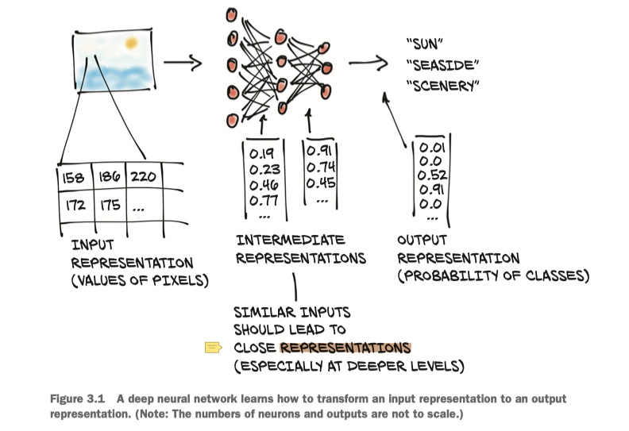
It starts with a tensor
A deep neural network typically learns the transformation from one form of data to another in stages, which means the partially transformed data
between each stage can be thought of as a sequence of intermediate representations.

Slide 5
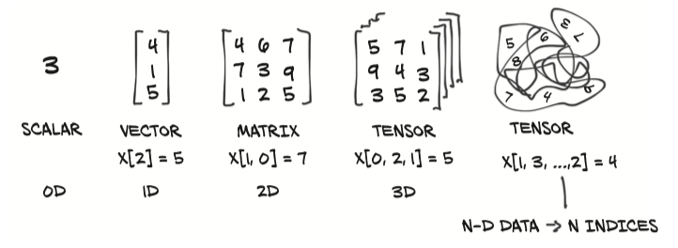
It starts with a tensor
3.2 Tensors: Multidimensional arrays
Compared to NumPy arrays, PyTorch tensors have a few superpowers, such as the ability to perform very fast operations on graphical processing units (GPUs), distribute operations on multiple devices or machines, and keep track of the graph of computations that created them. These are all important features when implementing a modern deep learning library.

Slide 6
It starts with a tensor
一张图片可以用三个字段表示
(width, height, color_depth) = 3D
很多张这样的图片
(sample_size, width, height, color_depth) = 4D

Slide 7

It starts with a tensor
3.2.2 Constructing our first tensors
conda install pytorch torchvision -c pytorch
conda install pytorch torchvision cudatoolkit=10.2 -c pytorch
官网：
https://pytorch.org/

Slide 8
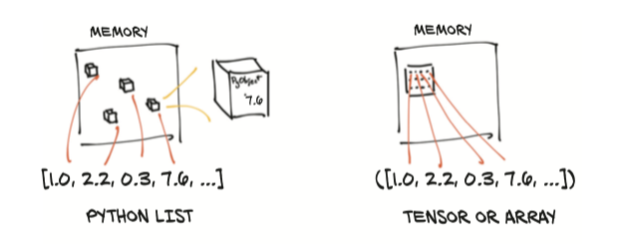
It starts with a tensor
3.2.3 The essence of tensors
Python lists or tuples of numbers are collections of Python objects that are individually allocated in memory, as shown on the left in figure 3.3. PyTorch tensors or NumPy arrays, on the other hand, are views over (typically) contiguous memory blocks containing unboxed C numeric types rather than Python objects. Each element is a 32-bit (4-byte) float in this case, as we can see on the right side of figure 3.3. This means storing a 1D tensor of 1,000,000 float numbers will require exactly 4,000,000 contiguous bytes, plus a small overhead for the metadata (such as dimensions and numeric type).

Slide 9
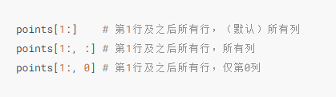
It starts with a tensor
3.3 Indexing tensors 张量索引
3.4 Named tensors 命名张量 https://pytorch.org/tutorials/intermediate/named_tensor_tutorial.html
The dimensions (or axes) of our tensors usually index something like pixel
locations or color channels. This means when we want to index into a tensor, we
need to remember the ordering of the dimensions and write our indexing
accordingly. As data is transformed through multiple tensors, keeping track of
which dimension contains what data can be error-prone.
Notes:
3.3 Indexing tensors

Slide 10
It starts with a tensor
广播
在pytorch的张量计算中，“广播”指的是当满足一定条件时，较小的张量能够自动扩张成合适尺寸的较大张量
需满足下列条件
1.每个张量至少有一个维度。
2.从尾部（也就是从后往前）开始，依次每个维度的尺寸必须满足以下之一：
（1）相等
（2）其中一个张量的维度尺寸为1
（3）其中一个张量不存在这个维度

Slide 11
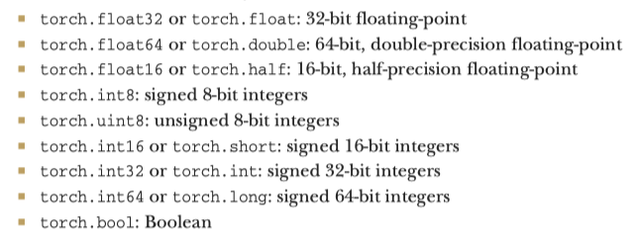
It starts with a tensor
3.5 Tensor element types
3.5.1 Specifying the numeric type with dtype

Slide 12
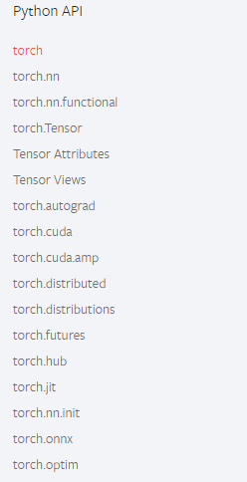
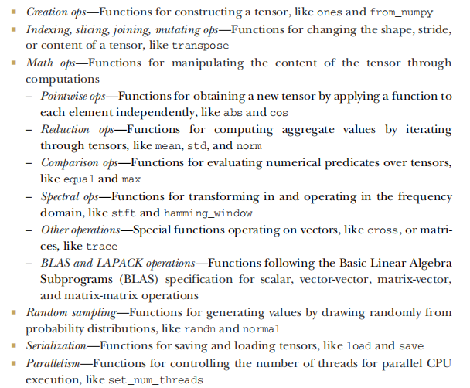
It starts with a tensor
3.6 The tensor API
https://pytorch.org/docs/stable/torch.html

Slide 13
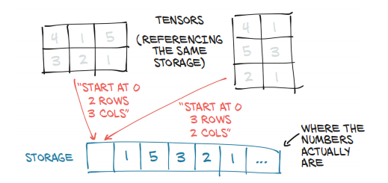
It starts with a tensor
3.7 Tensors: Scenic views of storage
Values in tensors are allocated in contiguous chunks of memory managed by torch.Storage instances. A storage is a one-dimensional array of numerical data: that is, a contiguous block of memory containing numbers of a given type, such as float (32 bits repre_x0002_senting a floating-point number) or int64 (64 bits representing an integer). A PyTorch Tensor instance is a view of such a Storage instance that is capable of indexing into that storage using an offset and per-dimension strides. Multiple tensors can index the same storage even if they index into the data differently. We can see an example of this in figure 3.4. In fact, when we requested points[0] in section 3.2, what we got back is another tensor that indexes the samestorage as the points tensor—just not all of it, and with different dimensionality (1D versus 2D). The underlying memory is allocated only once, however, so creating alter_x0002_nate tensor-views of the data can be done quickly regardless of the size of the data managed by the Storage instance.

Slide 14
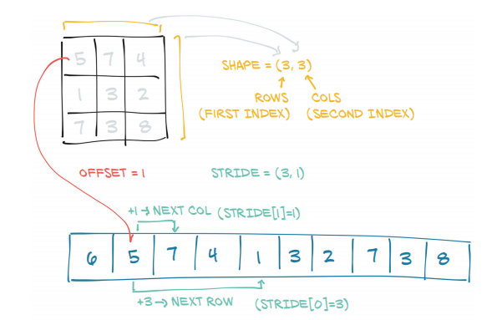
It starts with a tensor
3.8 Tensor metadata: Size, offset, and stride
In order to index into a storage, tensors rely on a few pieces of information that, together with their storage, unequivocally define them: size, offset, and stride. How these interact is shown in figure 3.5. The size (or shape, in NumPy parlance) is a tuple indicating how many elements across each dimension the tensor represents. The storage offset is the index in the storage corresponding to the first element in the tensor. The stride is the number of elements in the storage that need to be skipped over to obtain the next element along each dimension.

Slide 15
It starts with a tensor
size or shape：尺寸
offset：从存储数据开始的偏移
stride（元组）：步长
offset + stride[m] * i + stride[n] * j

Slide 16
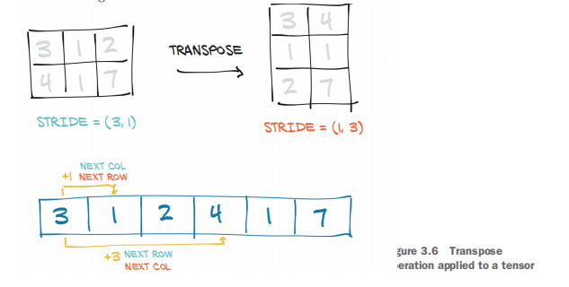
It starts with a tensor
3.8.2 Transposing without copying
This tells us that increasing the first index by one in points—for example, going from points[0,0] to points[1,0]—will skip along the storage by two elements, while increasing the second index—from points[0,0] to points[0,1]—will skip along the storage by one. In other words, the storage holds the elements in the tensor sequentially row by row. We can transpose points into points_t, as shown in figure 3.6. We change the order of the elements in the stride. After that, increasing the row (the first index of the tensor) will skip along the storage by one, just like when we were moving along columns in points. This is the very definition of transposing. No new memory is allocated: transposing is obtained only by creating a new Tensor instance with different stride ordering than the original.

Slide 17
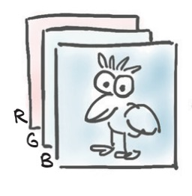
It starts with a tensor
3.9 Moving tensors to the GPU
So far in this chapter, when we’ve talked about storage, we’ve meant memory on the CPU. PyTorch tensors also can be stored on a different kind of processor: a graphics processing unit (GPU). Every PyTorch tensor can be transferred to (one of) the GPU(s) in order to perform massively parallel, fast computations. All operations that
will be performed on the tensor will be carried out using GPU-specific routines that come with PyTorch.
3.9.1 Managing a tensor’s device attribute
In addition to dtype, a PyTorch Tensor also has the notion of device, which is where on the computer the tensor data is placed. Here is how we can create a tensor on the GPU by specifying the corresponding argument to the constructor

Slide 18
It starts with a tensor
3.10 NumPy interoperability
We’ve mentioned NumPy here and there. While we do not consider NumPy a prereq_x0002_uisite for reading this book, we strongly encourage you to become familiar with NumPy due to its ubiquity in the Python data science ecosystem. PyTorch tensors can be converted to NumPy arrays and vice versa very efficiently. By doing so, we can take advantage of the huge swath of functionality in the wider Python ecosystem that has built up around the NumPy array type. This zero-copy interoperability with NumPy arrays is due to the storage system working with the Python buffer protocol (https://docs.python.org/3/c-api/buffer.html).

Slide 19
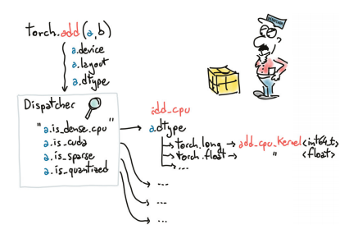
It starts with a tensor
3.11 Generalized tensors are tensors, too
There are other kinds of tensors: some are specific to certain classes of hardware devices (like Google TPUs), and others have data-representation strategies that differ from the dense array style we’ve seen so far.

Slide 20
It starts with a tensor
3.12 Serializing tensors
Creating a tensor on the fly is all well and good, but if the data inside is valuable, we will want to save it to a file and load it back at some point. After all, we don’t want to have to retrain a model from scratch every time we start running our program! PyTorch uses pickle under the hood to serialize the tensor object, plus dedicated serialization code for the storage.

Slide 21
It starts with a tensor
3.12.1 Serializing to HDF5 with h5py
$ conda install h5py

Slide 22
Summary

Slide 23
Summary
Now we have covered everything we need to get started with representing everything in floats. We’ll cover other aspects of tensors—such as creating views of tensors; indexing tensors with other tensors; and broadcasting, which simplifies performing element-wise operations between tensors of different sizes or shapes—as needed along the way

Slide 24

谢谢大家

